Slide 1
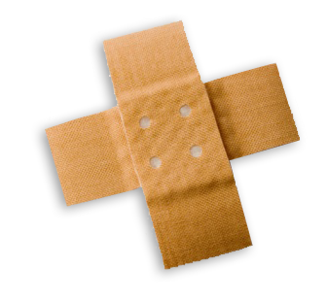
Basic First Aid for Medical Emergencies
BY :- SAILESH MAHAPATRA,
S.E.C.L., KORBA
SAILESH MAHAPATRA
Notes:
Slide Show Notes
When a serious injury occurs, you have to think and act quickly. Medical assistance may be only minutes away, but sometimes seconds count. What you do in those first few seconds and minutes can make the difference between life and death. Quick, calm, and correct action can make all the difference.
“First aid” is emergency care given to the sick or injured before medical personnel arrive. That’s why a knowledge of first aid and CPR (cardiopulmonary resuscitation) is so important. And that’s why you’re participating in this session today.
The purpose of this session is to provide you with a basic overview of first-aid techniques and priorities. It is not the same as a first-aid and CPR certification course. A certification course is much more detailed and offers you the opportunity to practice first-aid and CPR skills as well as to provide you with hours of classroom training.
We urge you to take a course and get certified. Taking a certification course will give you the full knowledge and confidence you need to use first-aid skills on the job, at home, and elsewhere in your community.
In the meantime, the information in this session can help you better handle medical emergencies when you are the first or only person on the scene.

Slide 2
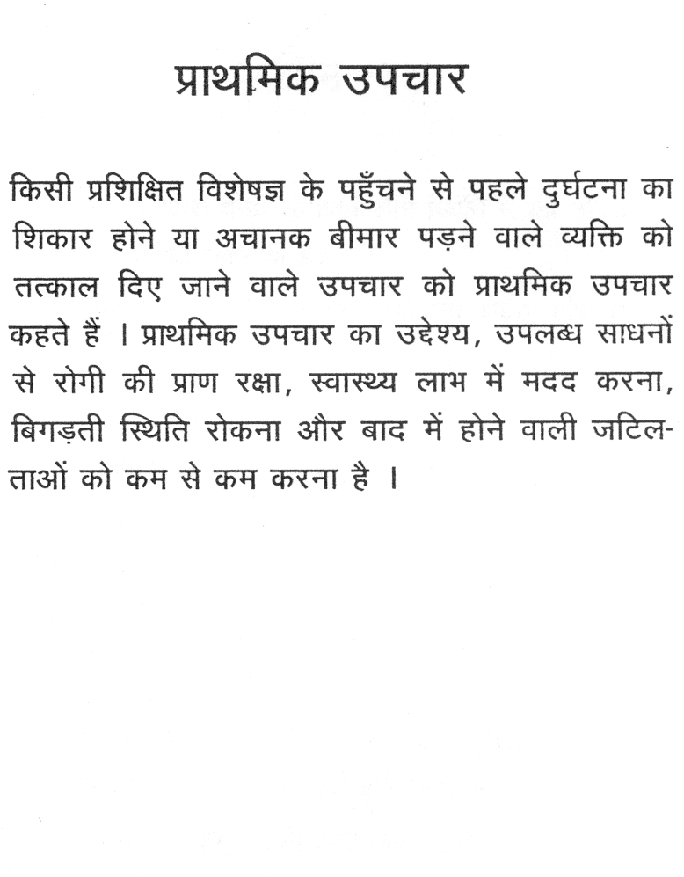
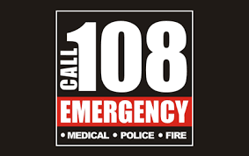
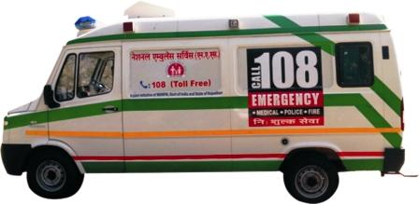
SAILESH MAHAPATRA

Slide 3
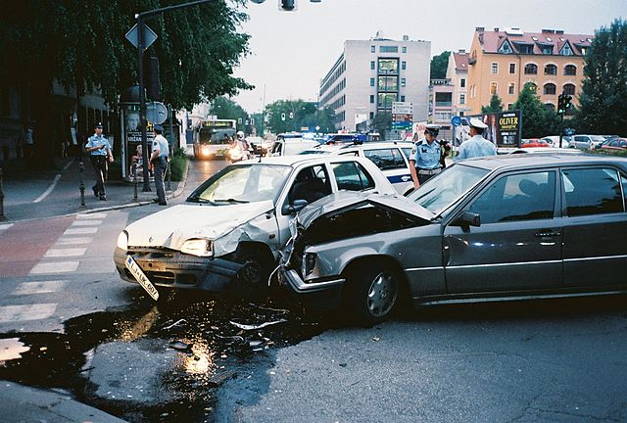
Exercise: incident management
Take a few minutes to discuss:
1) How would you manage this incident?
2) What dangers are present or could be present?
3) What should your first action be?
SAILESH MAHAPATRA
Notes:
*

Slide 4
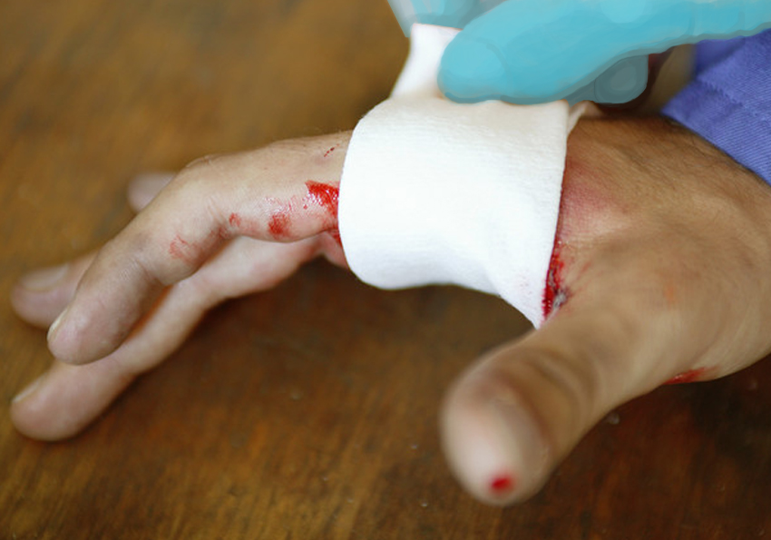
Bleeding
Stop the flow of blood
Wear gloves
Cover the wound
Apply pressure
SAILESH MAHAPATRA

Slide 5
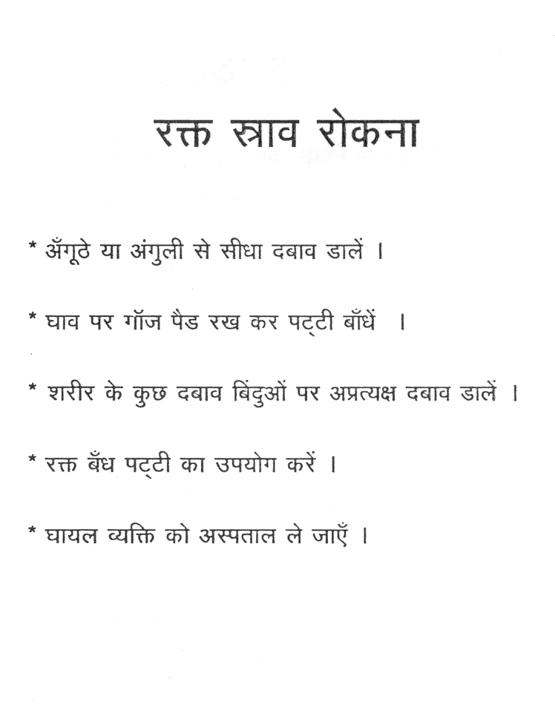
SAILESH MAHAPATRA

Slide 6

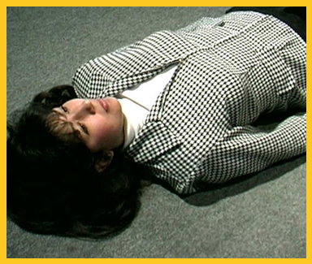
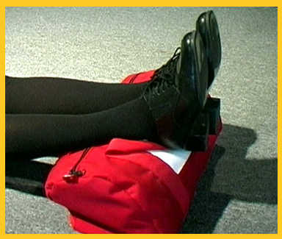
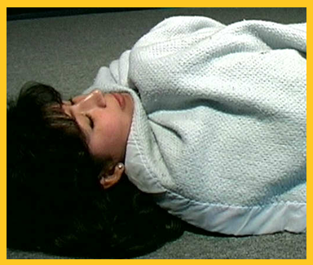

Shock
Lay the victim down
Cover
Raise feet
SAILESH MAHAPATRA
Notes:
Slide Show Notes
In cases where a person has lost a lot of blood, a condition known as shock can develop. Shock is the body’s way of reacting to severe injury. A person in shock may appear stunned or confused. To treat shock:
Lay the victim down,
Cover the victim to keep him or her warm, and
Raise the feet slightly above heart level.

Slide 7
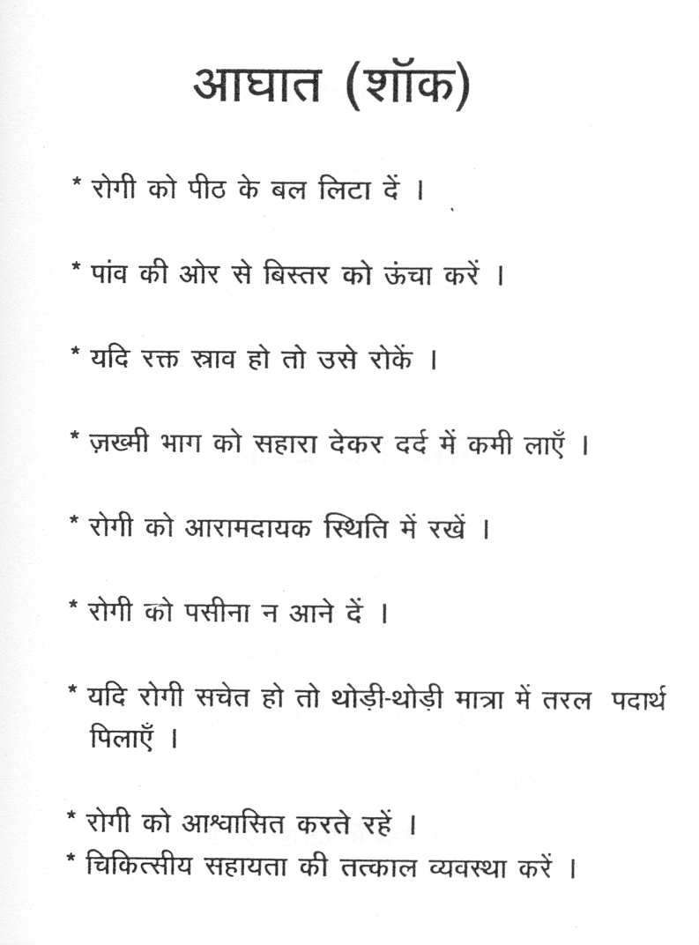
SAILESH MAHAPATRA

Slide 8
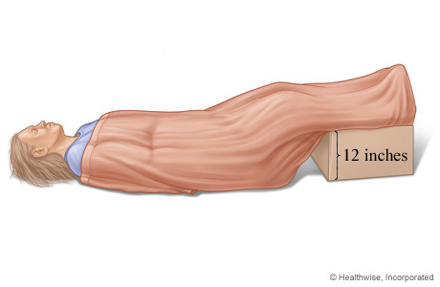
Photo: Treatment of shock
SAILESH MAHAPATRA
Notes:
*

Slide 9
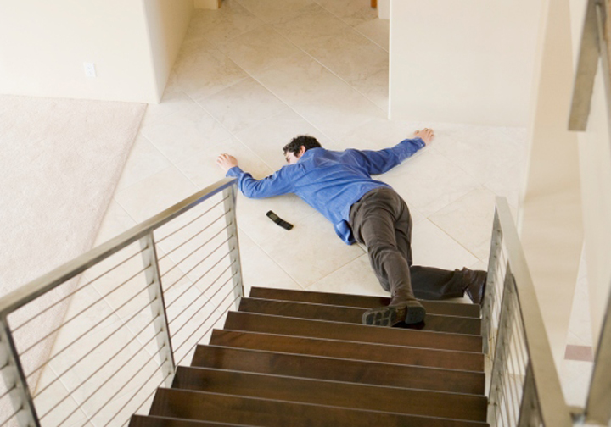
Broken Bones / FRACTURES
Look
Ask
Treat for shock
SAILESH MAHAPATRA
© Business & Legal Reports, Inc. 1110
Notes:
Slide Show Notes
The rule for treating people who may have broken bones is never to move them unless it’s necessary for their safety. Neck and back injuries are especially risky. The wrong move could cause paralysis or death. If you suspect broken bones, call for emergency medical assistance, and instruct the victim not to move.
Then look for swelling and deformity.
Ask the victim to rate the pain, explain how the injury happened, and if he or she can move the injured limb.
Treat for shock if the person shows symptoms.
If it seems that a person might have a broken bone, apply ice wrapped in a towel or cloth to the area, and keep the victim comfortable until help arrives.

Slide 10
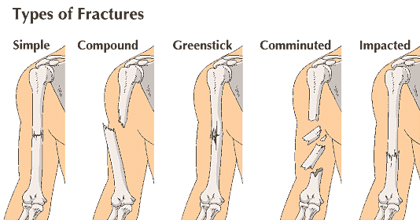
SAILESH MAHAPATRA

Slide 11
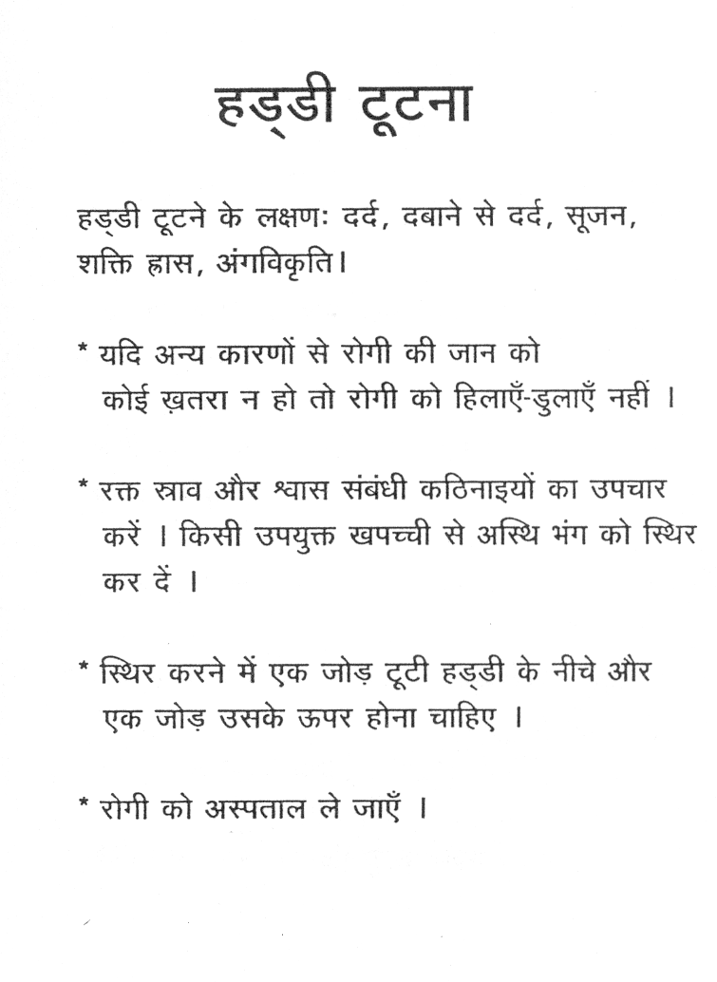
SAILESH MAHAPATRA

Slide 12
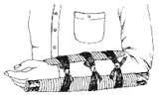
SAILESH MAHAPATRA

Slide 13
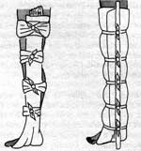
SAILESH MAHAPATRA

Slide 14
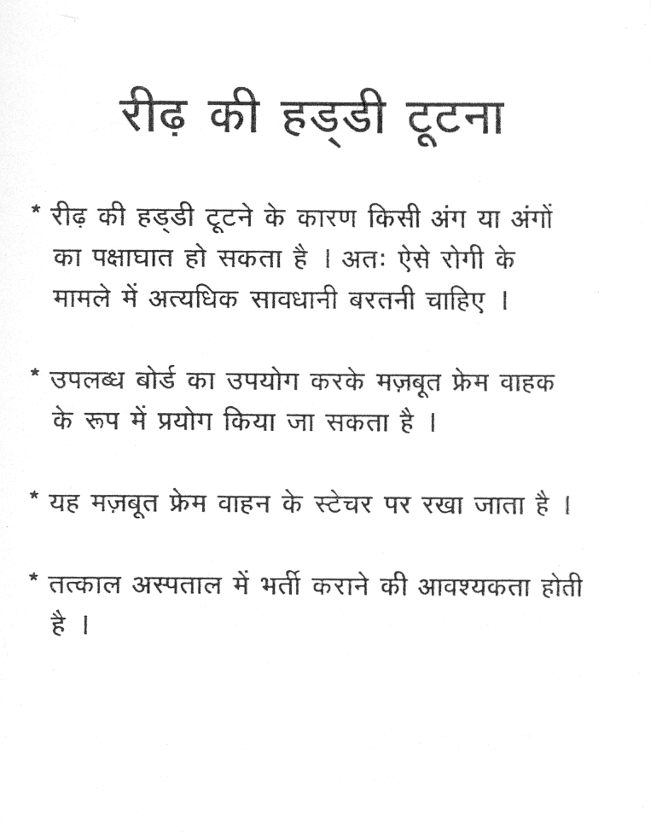

Slide 15
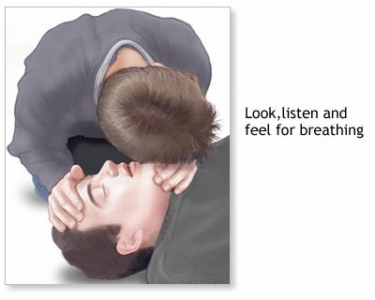
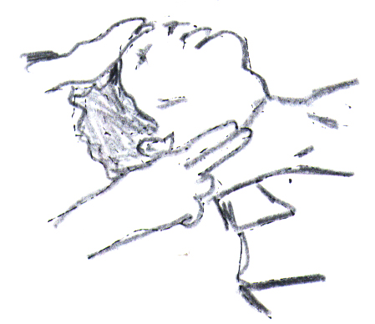
SAILESH MAHAPATRA

Slide 16

Cardio Pulmonary Resuscitation (CPR)
SAILESH MAHAPATRA
Notes:
*

Slide 17
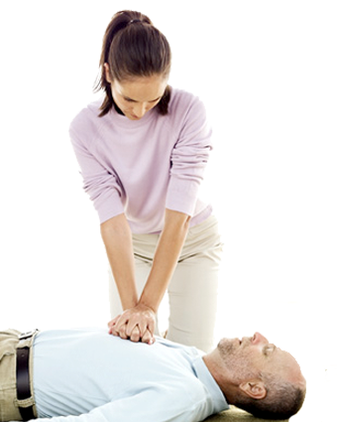
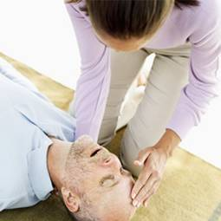
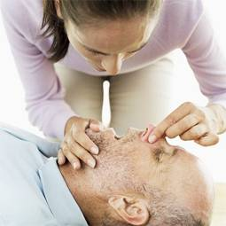
No Breathing
Administer CPR:
Lay the person on his or her back
Give chest compressions
Tilt head slightly
Breathe into the person’s mouth
Continue until EMS personnel arrive
SAILESH MAHAPATRA
Notes:
Slide Show Notes
Now let’s look at some specific medical emergencies. We’ll begin with no breathing. When a person is unconscious and not breathing, irreversible brain damage occurs within 3 minutes. You have to act very fast.
Someone trained in cardiopulmonary resuscitation, or CPR, should lay the person on his or her back while someone else calls 911. Loosen the clothes around the neck and make sure nothing is blocking the mouth or throat.
First, give 30 chest compressions by placing both hands in the center of the victim’s chest with one hand on top of the other and pressing down with the heel of your hand 1½ to 2 inches. Press quickly at a rate of about 100 compressions a minute.
Next, open the airway by tilting the head slightly and lifting under the chin. Do not move the victim’s head back if you suspect a neck injury.
Form a seal around the mouth and pinch the nose. Use a pocket mask if you are trained in its proper use. Breathe two slow breaths into the person’s mouth—enough to make the chest rise and fall. Then, continue chest compressions.
Once you begin CPR, continue until EMS personnel arrive.

Slide 18
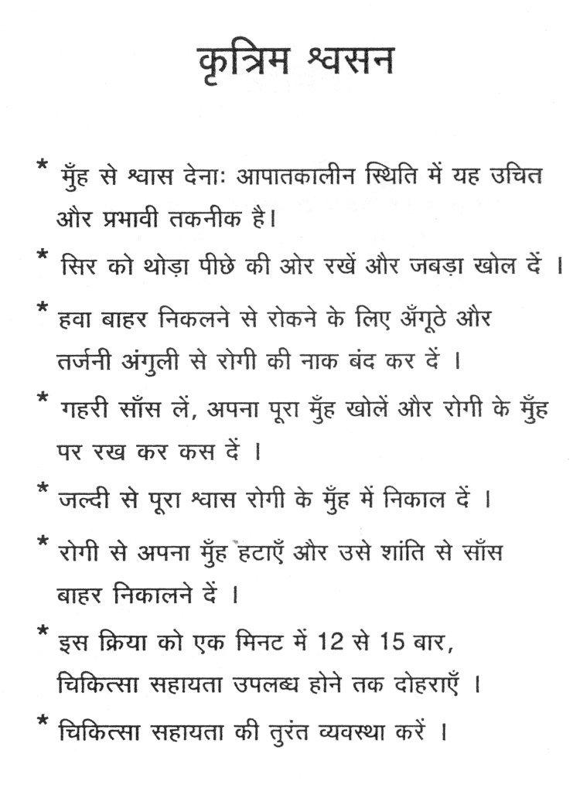
SAILESH MAHAPATRA

Slide 19
First aid for burns
SAILESH MAHAPATRA
Notes:
*

Slide 20
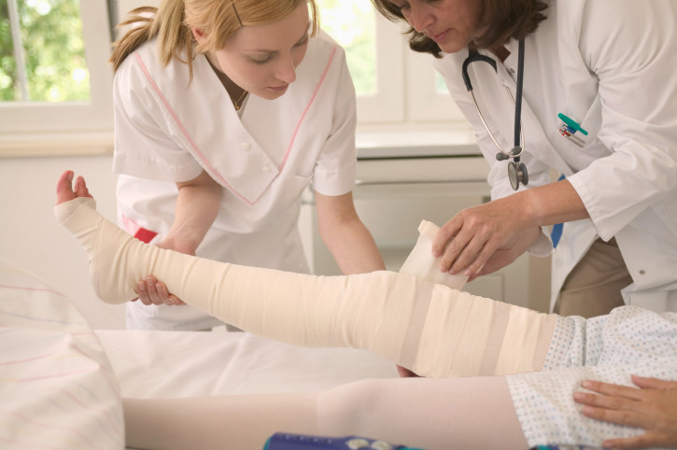



Burns
First-degree burns—Reddened, painful skin
Second-degree burns—Blistering
Third-degree burns—Charring, deep tissue damage
SAILESH MAHAPATRA
Notes:
Slide Show Notes
Burns are another common workplace hazard. You can be burned by hot surfaces, hot materials, or by the properties of certain materials. First aid for burns depends on the degree of the burn.
First-degree burns are the least severe. They just involve the top layer of skin, which becomes reddened and painful.
Second-degree burns are more serious and include blistering in addition to reddened skin and pain. First- and second-degree burns may be treated with cold, running water for relief of pain. Then cover the burned area with a moist, sterile dressing. Don’t break blisters on second-degree burns.
Third-degree burns are the most serious and can even be life threatening. With third-degree burns the skin is destroyed, you see charring and deep tissue damage. You may even see exposed bones. For third-degree burns, call 911 immediately, and keep the victim comfortable until help arrives.
Always get immediate medical attention for all burns, especially those that are severe and those that cover large areas of the body.

Slide 21
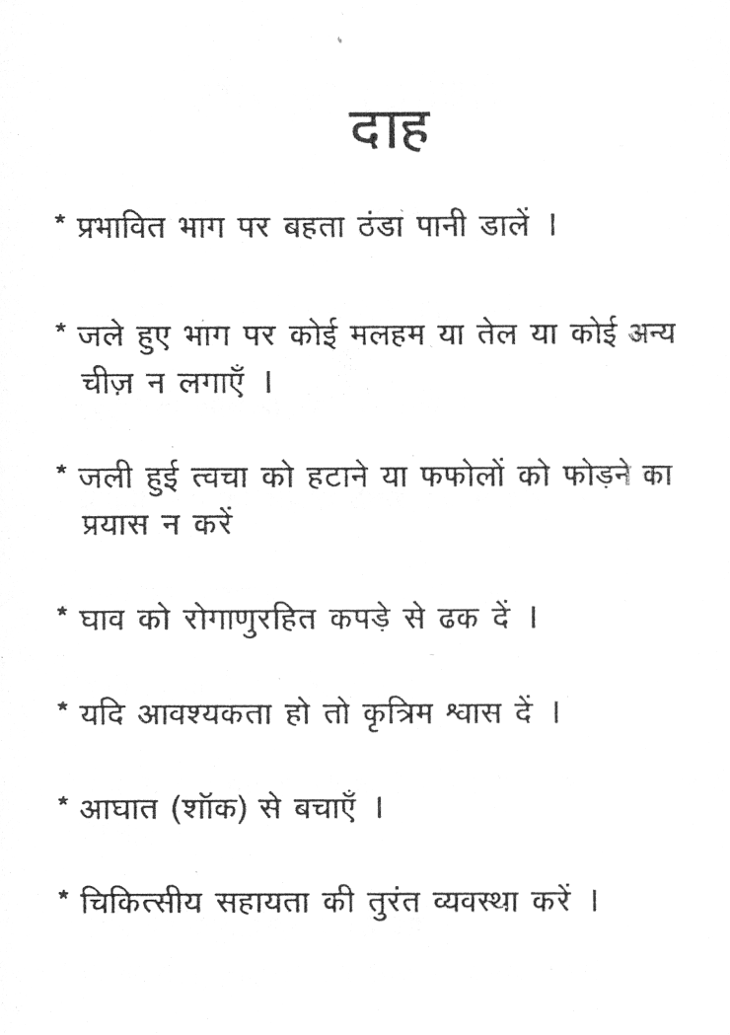

Slide 22
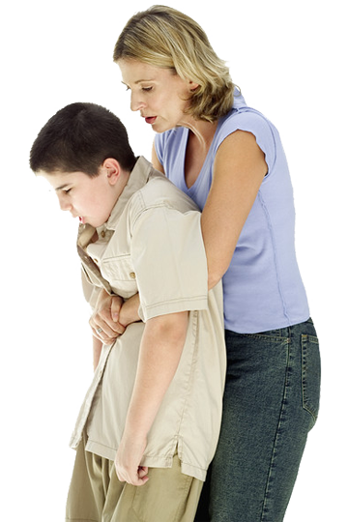
Choking
Ask a person to speak or cough
Deliver 5 back blows
Perform abdominal thrusts
Repeat sequence of back blows and abdominal thrusts
SAILESH MAHAPATRA
Notes:
Slide Show Notes
A person can choke to death in a couple of minutes.
The fastest way to find out if someone is choking is to ask, “Are you choking?” If the person can cough or talk, he or she is not choking.
But if the person can’t talk or cough, first deliver 5 back blows between the person’s shoulder blades with the heel of your hand.
If the back blows don’t clear the object from the throat, perform abdominal thrusts:
Stand behind the victim and wrap your arms around the waist.
Make a fist with one hand. Place your fist, thumb-side in, against the victim’s stomach—above the navel but below the ribs. Grab your fist with your other hand.
Pull in and up sharply and repeat if necessary to dislodge whatever is stuck in the throat.
Repeat the sequence of 5 back blows and 5 abdominal thrusts until the object is cleared.
Do you know how to perform abdominal thrusts? Everybody should. It’s simple, and it can save a life.
Demonstrate abdominal thrusts without using force on a volunteer from the group, and then give trainees the chance to practice it on one another.

Slide 23

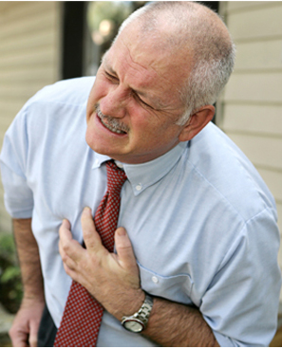
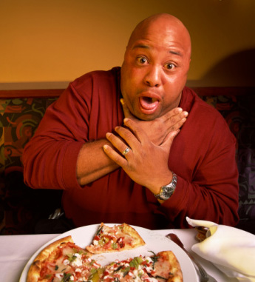
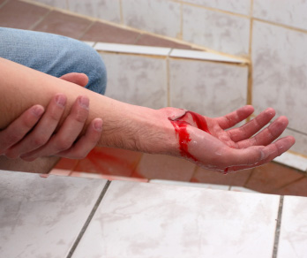
Help! Emergency!
Minutes could make a difference
SAILESH MAHAPATRA
Notes:
Slide Show Notes
Just imagine:
A co-worker is hurt in an accident and blood is gushing from the wound.
One of your friends chokes on a piece of food and can’t breathe.
Someone goes into cardiac arrest right at his workstation.
Any one of these things is possible, and it could happen any time. If it did, you’d have to act fast. A few critical minutes one way or the other could make the difference between life and death. Would you be ready to act with speed and competence in a workplace medical emergency?
There are medical emergencies in workplaces across the country every day. Situations calling for first aid range from burns to cuts and amputations, eye injuries, chemical overexposures, and much more.
Do you know how to report a workplace medical emergency? Besides calling 911, you also need to notify a supervisor or manager and provide as much information as you can about the accident.
Describe the procedure for reporting workplace accidents and the information trainees should be prepared to provide about the incident.

Slide 24
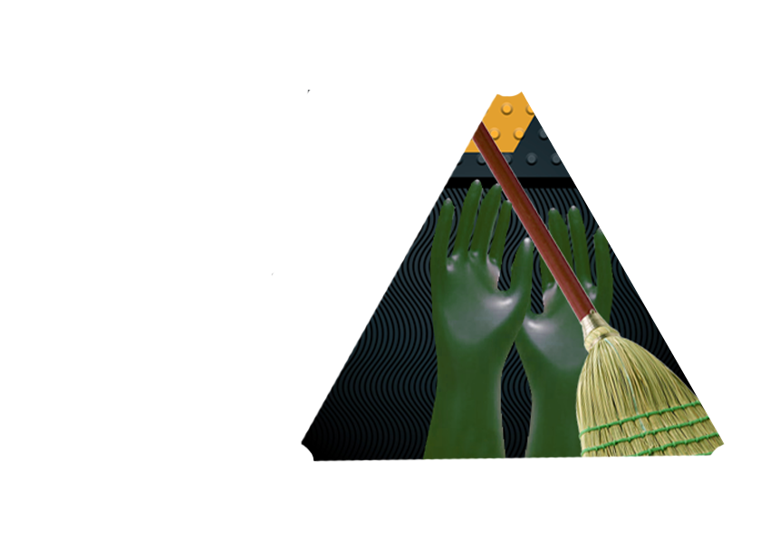
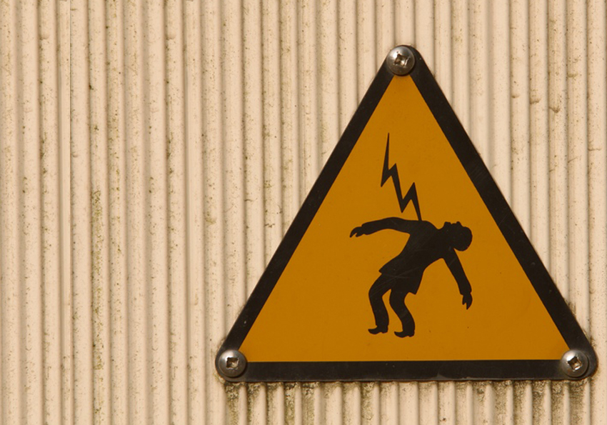
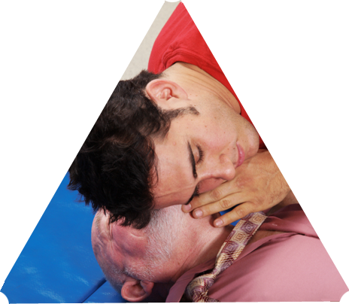
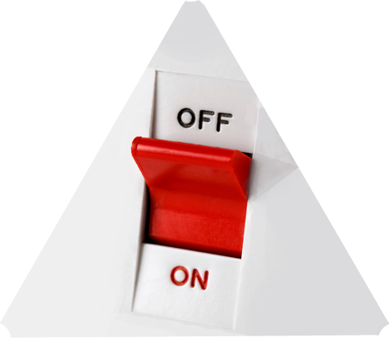
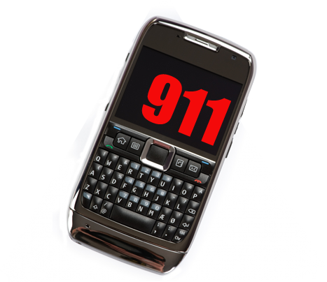

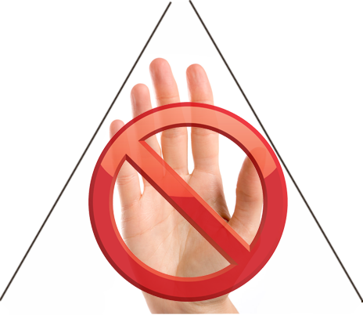




Electrical Shock
Don’t touch!
Turn power off
Call 108
Remove person from live wire
Check for breathing
SAILESH MAHAPATRA
© Business & Legal Reports, Inc. 1110
Notes:
Slide Show Notes
The first rule of dealing with electrical shock is not to touch a person who is in contact with a live electrical current. If you do, the current can pass right through the person to you and cause the same injury.
So the first thing you should do is to turn off the power to the electrical equipment involved.
Then call 108. Electrical shocks can be life threatening. You want to get EMS personnel on the scene quickly in case the victim has stopped breathing.
If you have to remove a person from a live wire, be very careful so you don’t get a shock, too. Stand on something that’s an insulator, like a rubber mat; wear rubber gloves; and use a dry stick, wooden broom handle, or board to push the person away from the wire. Don’t use anything metal, wet, or damp.
Once the victim is safe, check for breathing. Begin CPR if the person is not breathing.

Slide 25
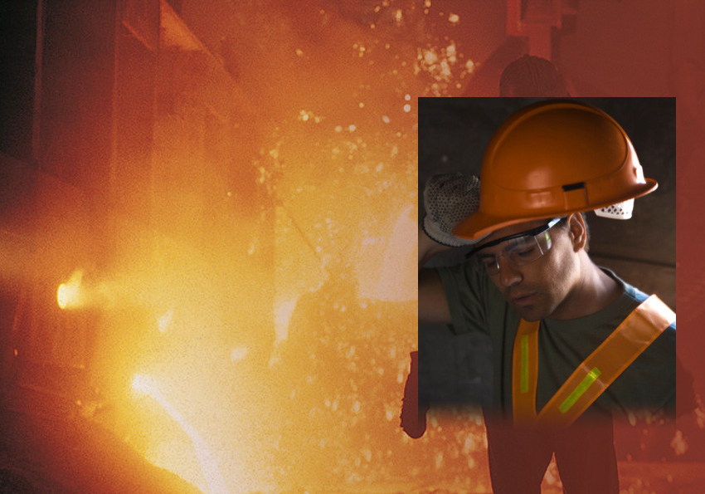
Heat Exhaustion
Move to cool place
Lay victim down
Elevate feet
Loosen clothing
Give fluids
Apply cool compresses
© Business & Legal Reports, Inc. 1110
Notes:
Slide Show Notes
Working in a hot environment or on a hot day can be very stressful for your body, especially if you’re not used to the heat.
Heat exhaustion may start out as discomfort and fatigue but can quickly develop into something more serious. Symptoms of heat exhaustion include pale or flushed appearance, weakness, heavy sweating, headache, moist and clammy skin, dizziness, and sometimes, nausea or a slight fever.
First aid for heat exhaustion involves these steps:
Move the victim to a cool place;
Have the person lie down;
Elevate feet 8 to 10 inches;
Loosen clothing;
Give the victim water and encourage him or her to drink slowly; and
Apply cool compresses to the head and body.
Do not administer “salt tablets,” as these are a high blood pressure risk.

Slide 26
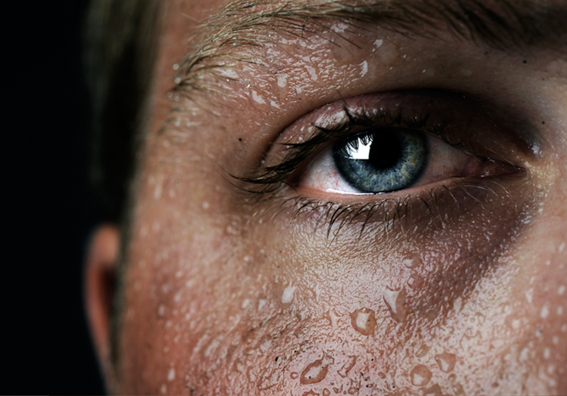
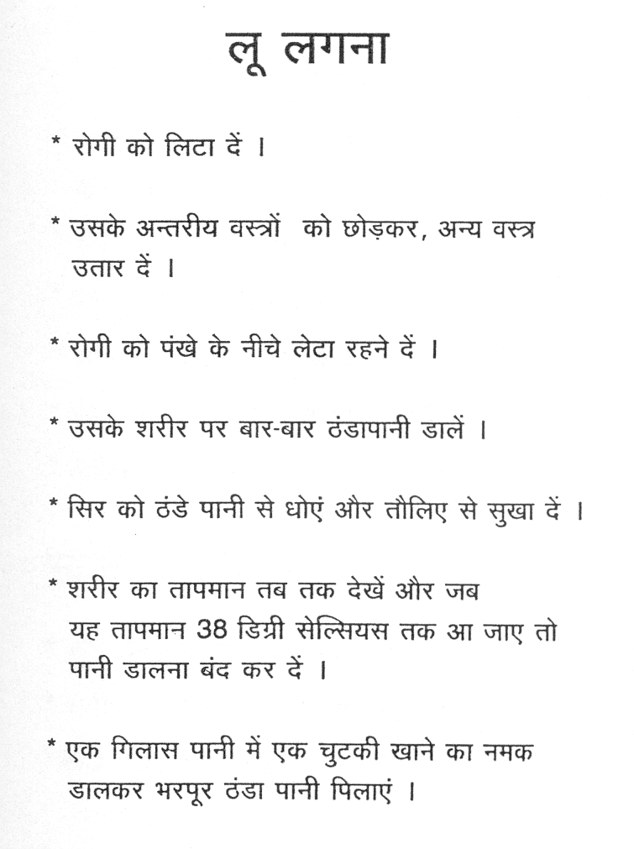
Heatstroke
Immediately call 108
Cool the person down
Monitor
SAILESH MAHAPATRA
© Business & Legal Reports, Inc. 1110
Notes:
Slide Show Notes
If a person suffering from heat exhaustion is not treated promptly, it can turn into heatstroke. Heatstroke is a life-threatening condition in which the body gets so hot that it can’t cool down. Signs of heatstroke include very hot and dry skin, extreme tiredness, and confusion.
You have to act fast in cases of heatstroke. Immediately call 911.
While you’re waiting for help to arrive, cool the person down by hosing his or her body with cool water or by fanning the body.
Monitor the victim to make sure the airway remains open, the person is breathing, and the person has a pulse.
If you work in a hot environment or if you exercise or work outdoors on hot days, you should recognize the symptoms of heatstroke and take precautions to prevent overheating.
Describe precautions for preventing heatstroke, such as drinking lots of fluids, pacing yourself while you work, taking rest breaks in a cool place, and so on.

Slide 27
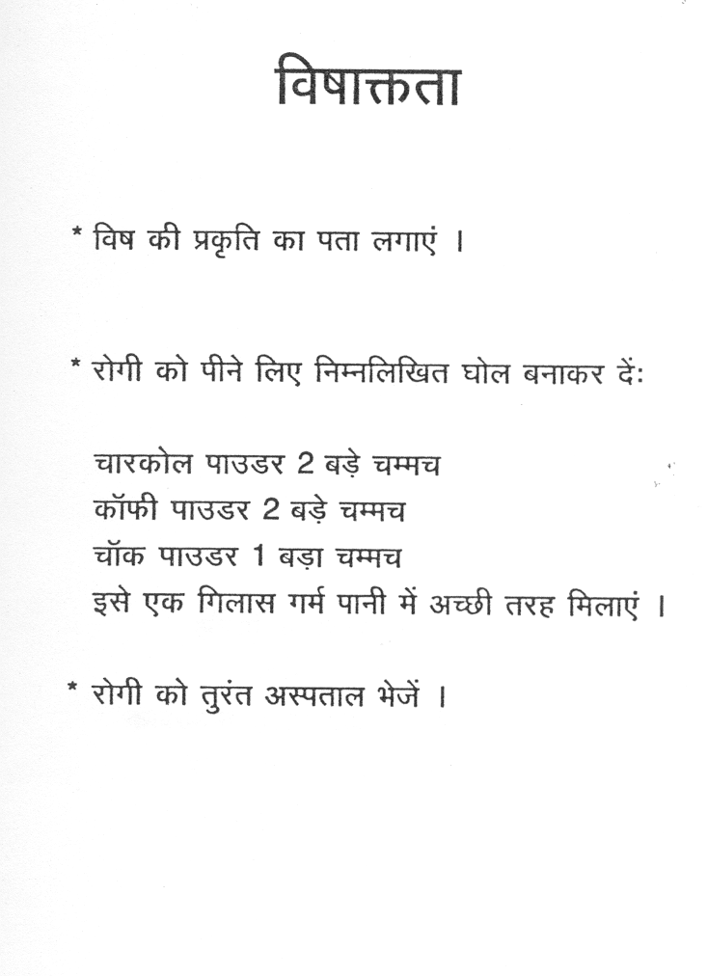
SAILESH MAHAPATRA

Slide 28
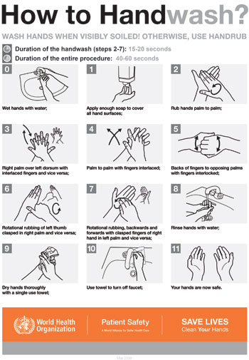
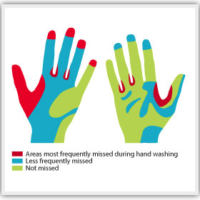
Handwashing
Alcohol handrub / handgel can be used if running water is not immediately available
SAILESH MAHAPATRA
Notes:
*

Slide 29
THANK YOU
SAILESH MAHAPATRA

